Slide 1

1. TESFAYE ADUGNA UGR/4709/12
2. TESHOME NBRET UGR/3281/12
3. KENNA TEFERA UGR/3281/12
4. ENDALE YOHANNES UGR/7379/12
5. Rediet Ferew UGR/1415/12
6. GIZAW DAGNE UGR/6640/12

Slide 2
Zehabesha.com
About zehabesha:
ZeHabesha is an extensive Ethiopian Latest news source.
Problems in zehabesha.com:
The navigation lacks proper organization and layout. The navigation disappears when scrolled up and then become partially visible.
Content repetitions are also seen.
The whole footer is taken by the logo.
The Accessibility of the website is also a concern. The logo of the website has no alternative text thus users using screen readers cannot access the content.
In addition to alternative text, labels for form controls are also important to improve accessibility of contents which zehabesha.com does not posses.

Slide 3
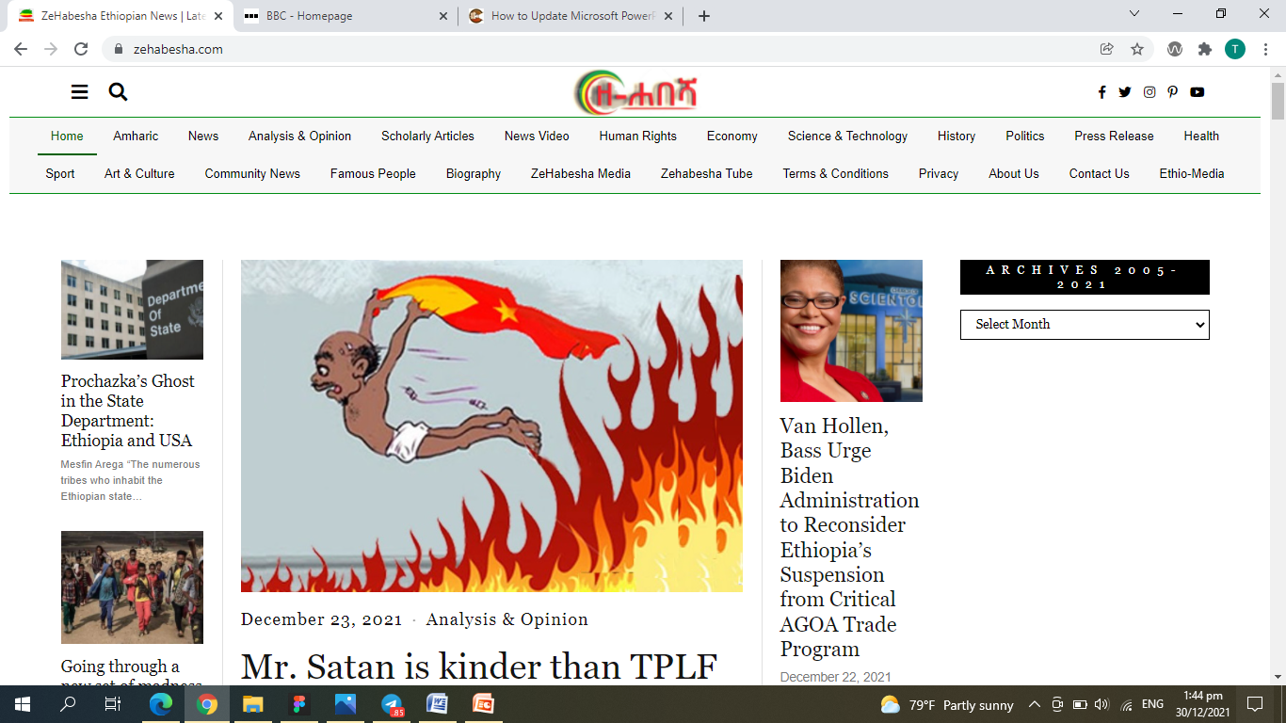
Originally the website looks like this

Slide 4
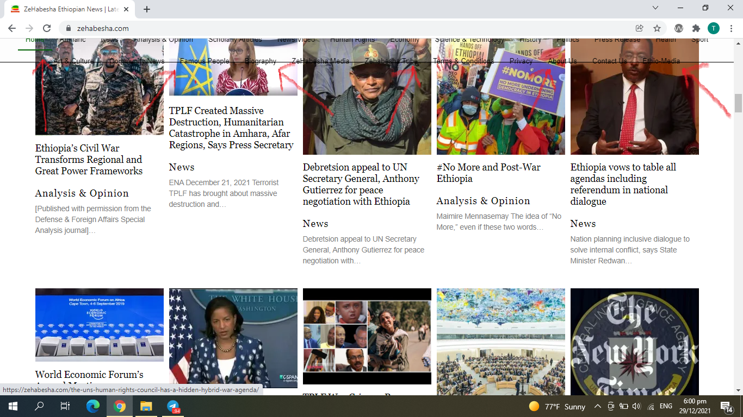
While scrolling The navigation is messed

Slide 5
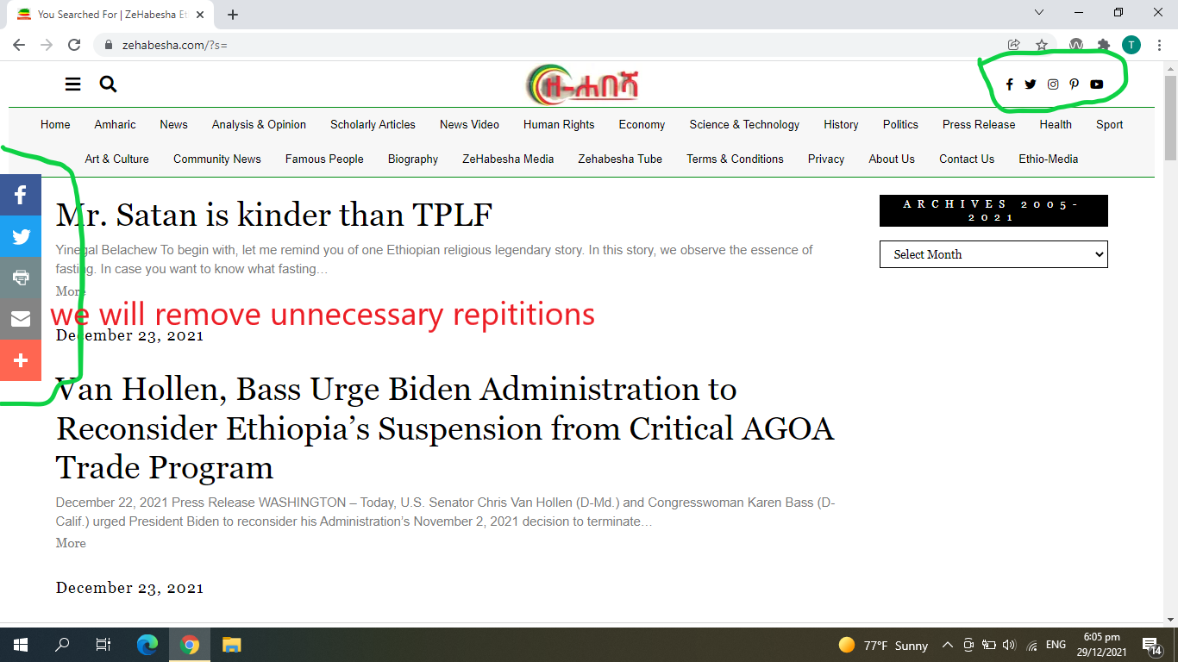
Unnecessary Repetition

Slide 6
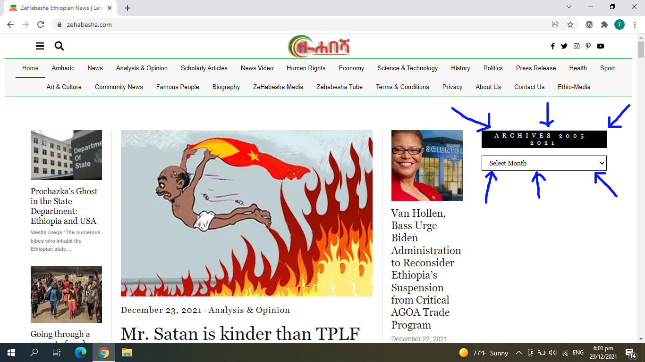
Archives is not in the right place

Slide 7
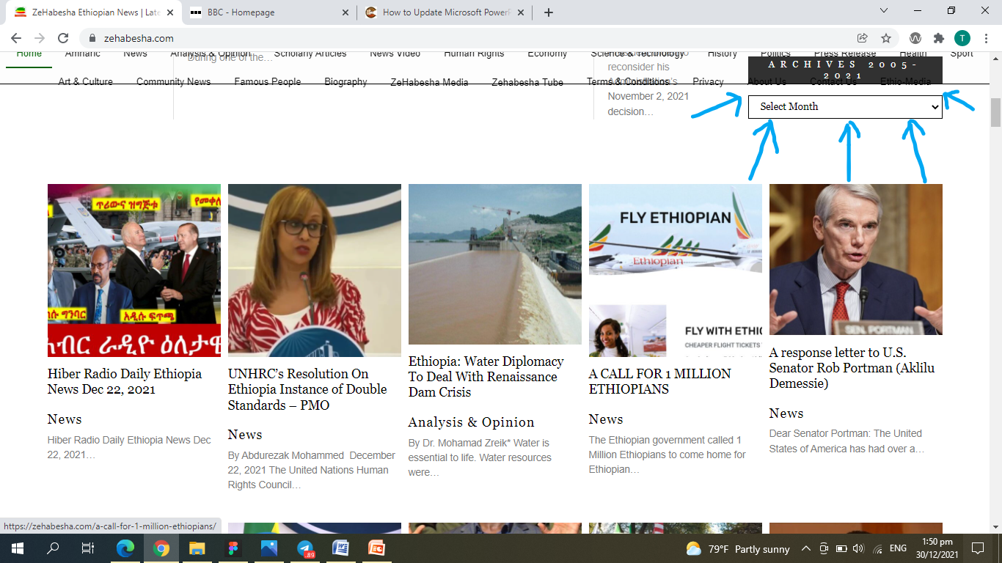
Again while scrolling archives loses it’s place

Slide 8
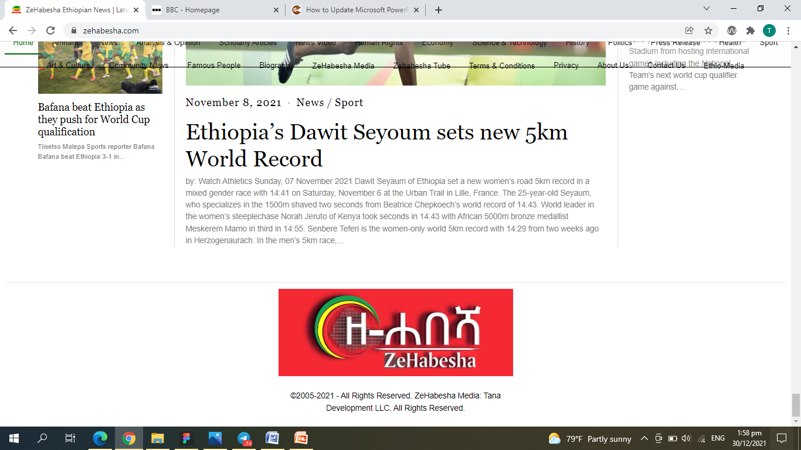
The footer originally looks like this

Slide 9
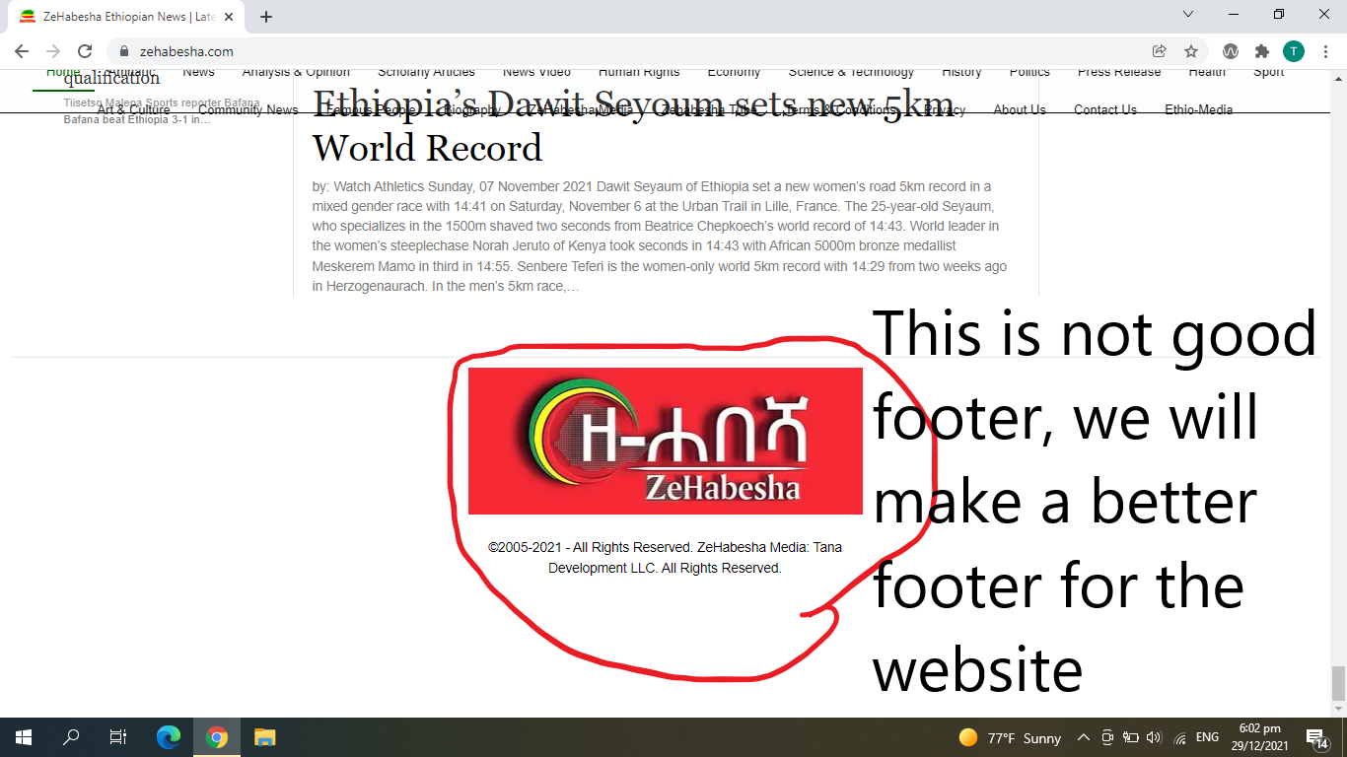
The problem with the footer

Slide 10

SOLUTIONS

Slide 11
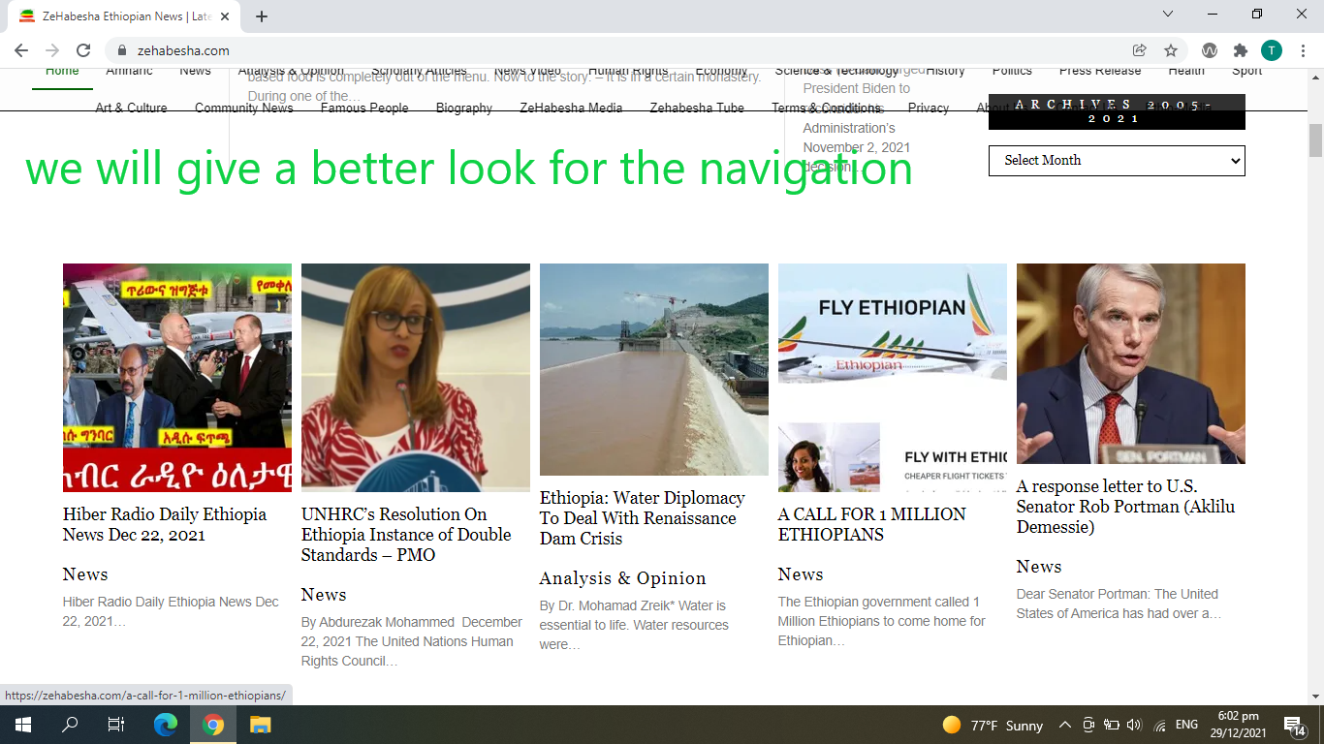
Solutions…

Slide 12
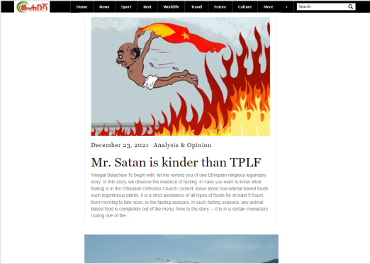
Solutions for navigation

Slide 13
